Slide 1
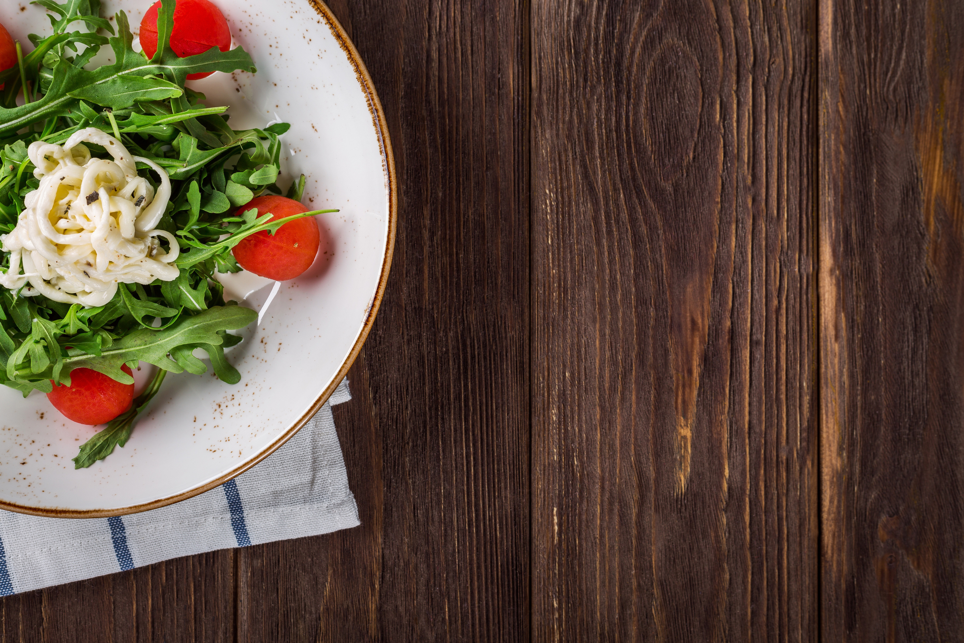
Food Dishes Catalog
Web Application
Sai Niketh(2020MT60895)
Ritika(2020MT10838)
Ankush(2020CH10073)

Slide 2
Problem Statement
The current state of food-related data on the internet is chaotic and disorganized, making it difficult for users to find the information they need.
Our database aims to solve this problem by offering a structured and user-friendly interface.

Slide 3


Outline of Our Idea
User
Portal
Admin
Portal
Verifies the information given by users and adds it to database
For users to get details of their favourite food
User
functionalities
User-generated
content
User added items are verified in backend by admin
Users can filter food, and add new items

Slide 4

Problem we are solving
The web applications consist of data on dishes, including information such as country of origin, type of dish, recipes, etc.
The user portal renders this information and has functionalities like searching, filtering based on the category, and adding a dish to the favorites
Users with knowledge of a dish can contribute details about it
User-provided details go through an admin approval process before being added to the database to ensure data integrity
A secure portal empowers admins to verify the validity of user-provided details before incorporating them into the system

Slide 5
Techstack for the Application
Front-end Development
We will use HTML, CSS, and React.js for an interactive web interface
Back-end Development
We will use Golang
Database Management
We will use the PostgreSQL database to store the data in tabular form
Collaborating Tools
We will use Postman for API testing, and GIT for version control

Slide 6

Azure Services
We will use Azure app services to host our application.
Azure Blob storage stores the recipes as unstructured text data.
Azure Functions are triggered when users submit new dish information.
Functions can send notifications to the admin portal within AAD for verification.
We plan to employ a load balancer to manage the workload and implement failover systems to address unexpected failures.

Slide 7
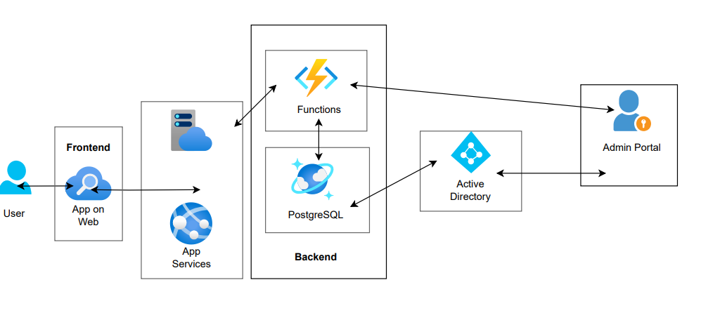
Our Model

Slide 8

Future Work
Build Food Community so that users can interact with each other directly
Add more functionality and features to our data, like allowing users to rate and review dishes and display average ratings for each dish
Integrate analytics tools to track user interactions, user demographics, and other metrics to improve the app's performance and user engagement

Slide 9
Thank you

